Slide 1
Exam 1
Given in class on Thursday, February 22
CLOSED book, CLOSED note, open calculator
Can bring 1 sheet of paper of notes
front and back
Have entire class period
2-3 Numerical Problems, 1-2 True/False
Previous Exam 1s to be posted on Piazza
Versions with and without solutions
Look at version w/o solution first

Slide 2

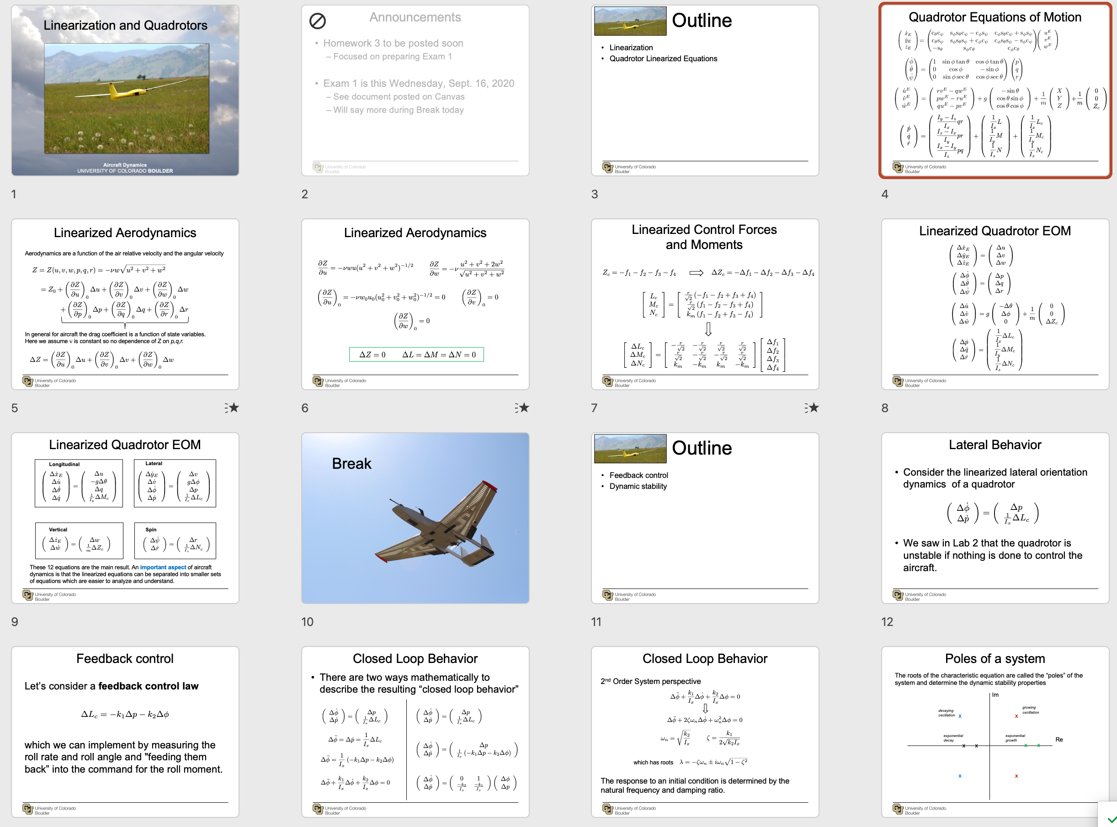
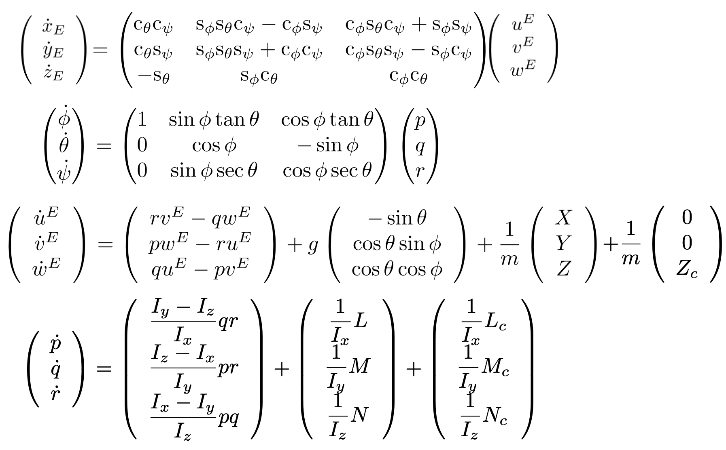
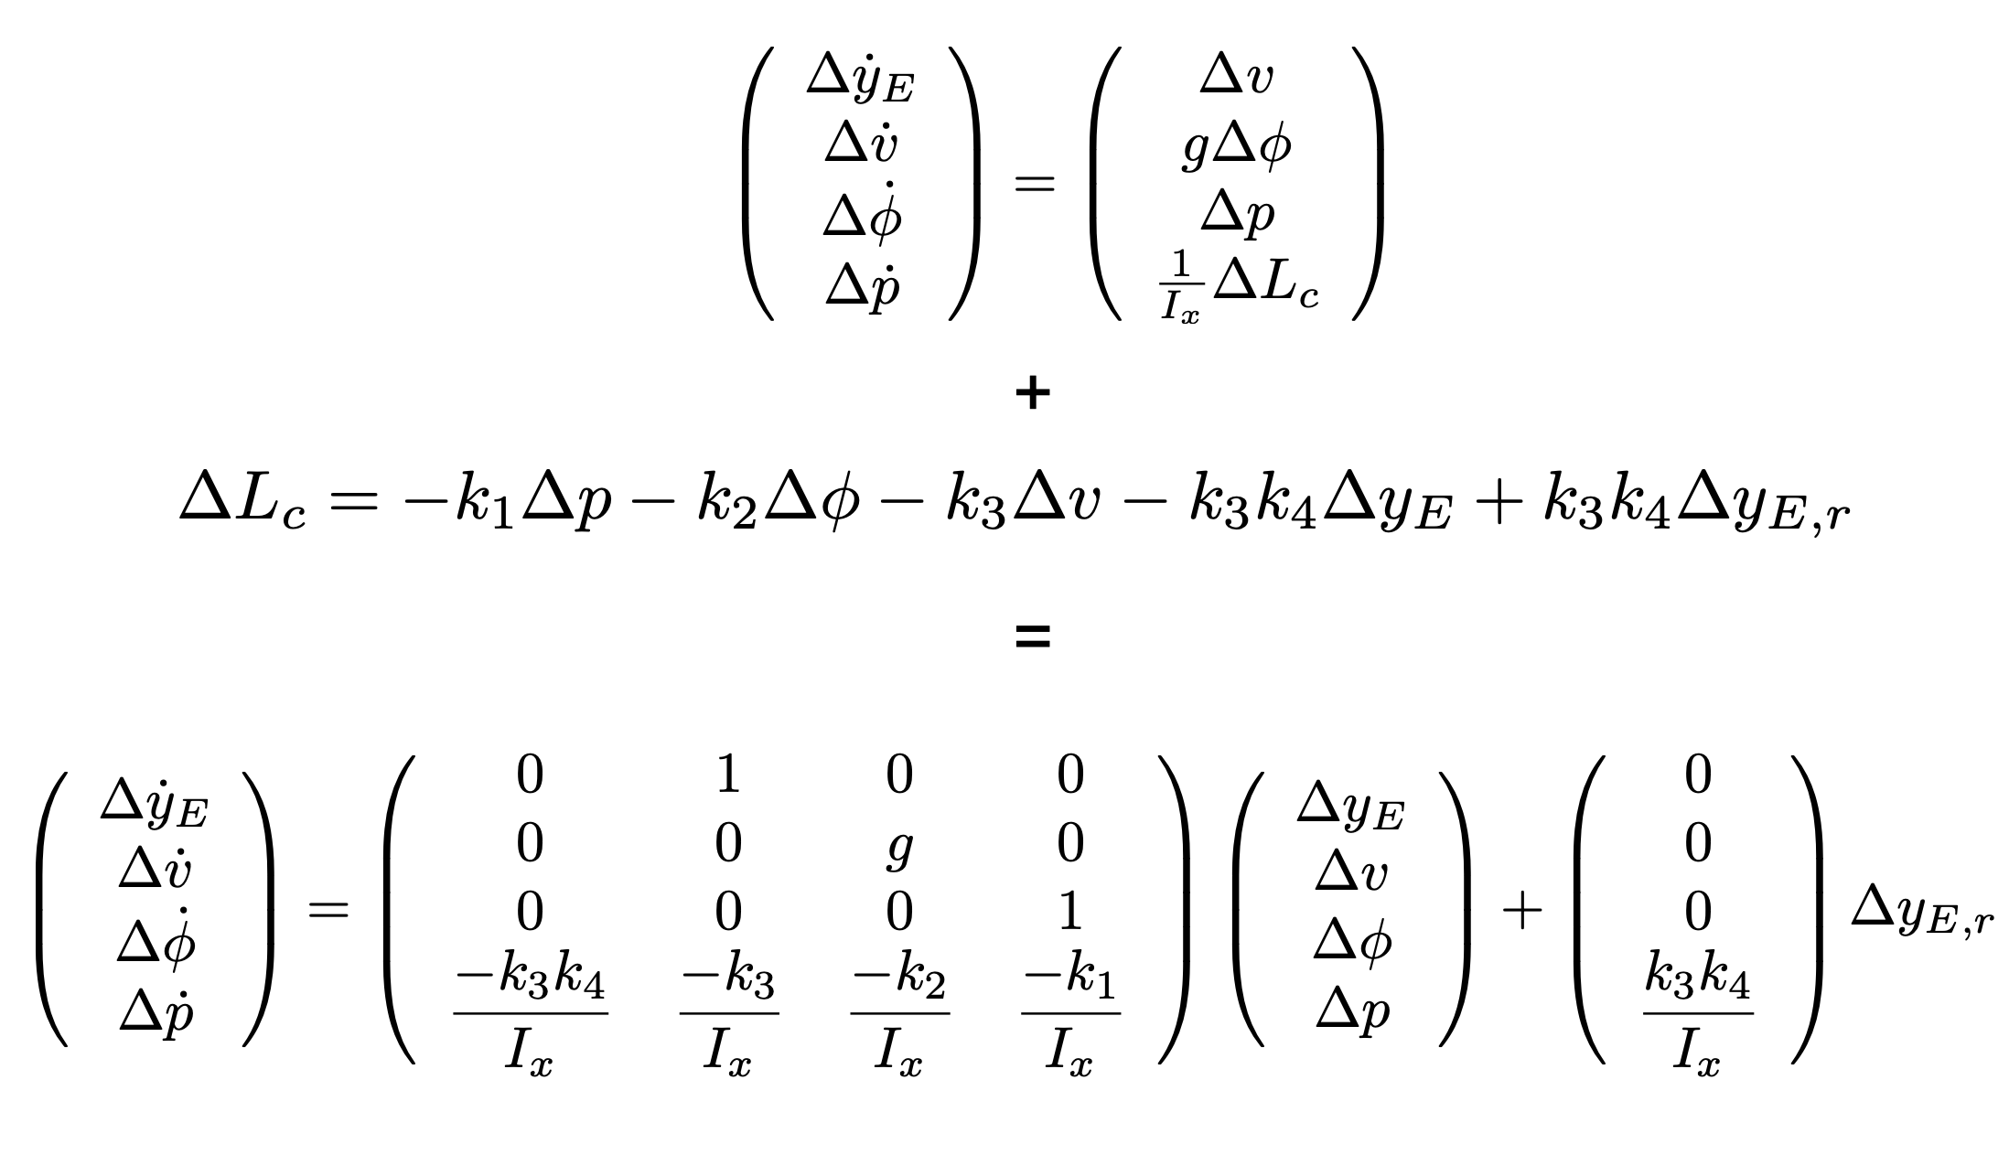

Slide 3
Topics to Study
Notation and nomenclature
Symbols and words
Rotations and Euler angles
Vector derivatives when coordinate system is rotating
Aircraft state vector
Aircraft equations of motion
Quadrotor equations
Poles and Modal analysis

Slide 4

Do u think I can skip studying since when we get a cheat sheet
nah because u still need to know which eqn to use

Slide 5
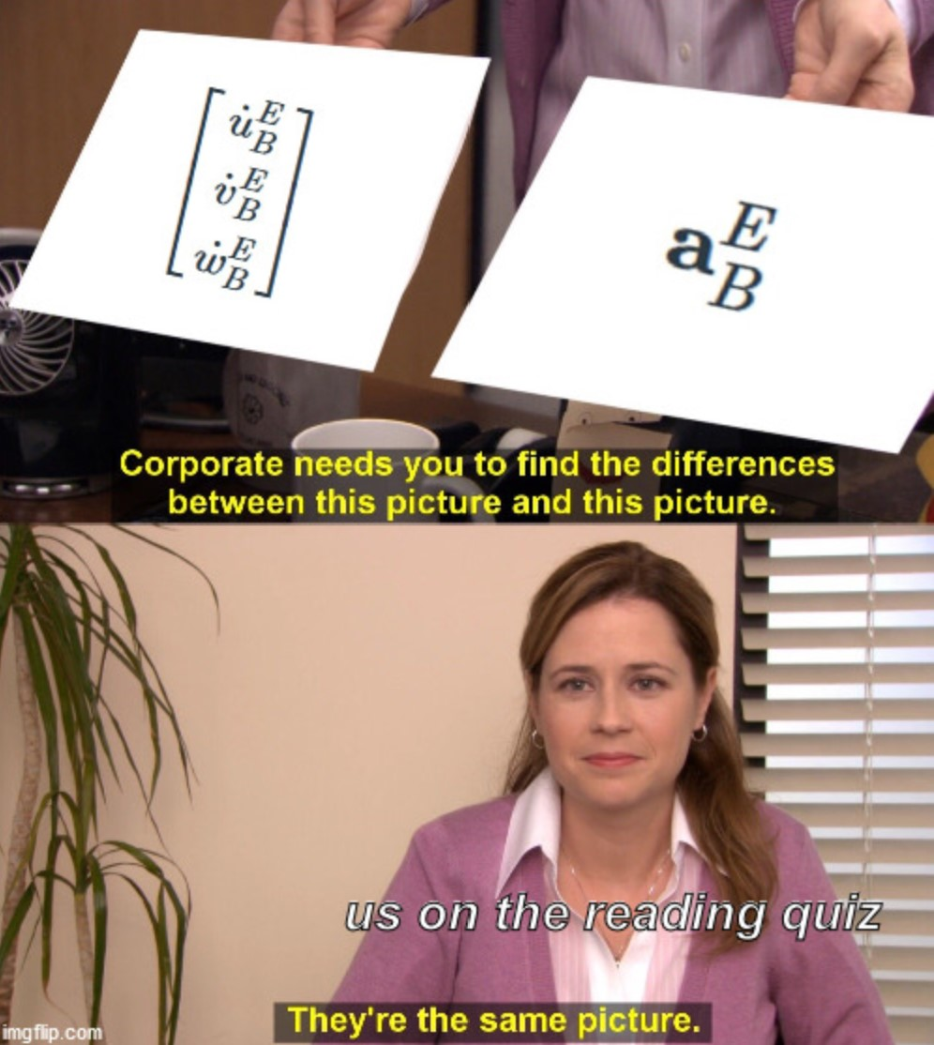
Terms
What are the variables and meaning of the terms:
Pitch angle
Pitch rate
Time rate of change of the pitch angle
Pitch moment

Slide 6
Terms
What are the variables and meaning of the terms:
Pitch angle = θ
one of three Euler angles describing the aircraft orientation; this angle describes rotation about the first intermediate frame’s y-axis
Pitch rate = q
y-component of the angular velocity vector expressed in body coordinates
Time rate of change of the pitch angle =
as it says, the time rate of change of θ
Pitch moment = M
y-component of the aerodynamic moment expressed in body coordinates

Slide 7
Example Types of Questions
If given a vector in body coordinates and the aircraft Euler angles, how do you calculate the vector in inertial coordinates?
Given the aircraft (fixed wing or quadrotor) state, determine something about the aircraft

Slide 8
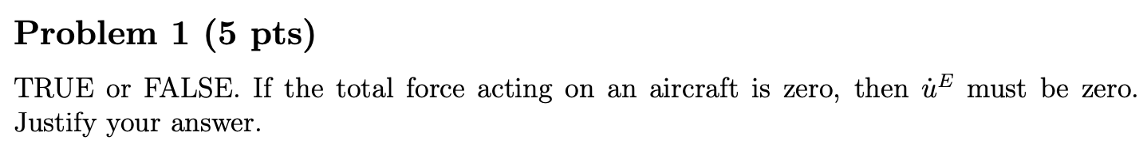
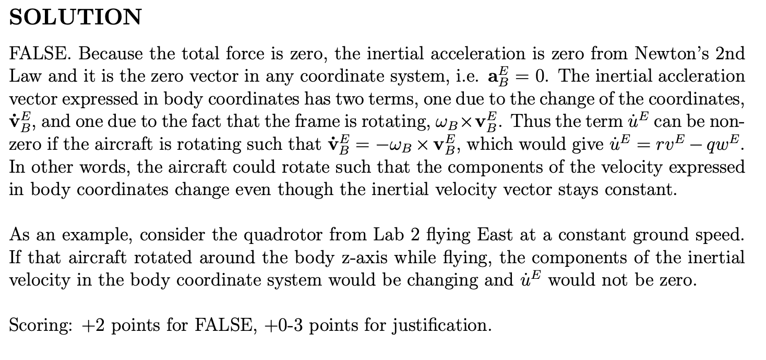
2021: Problem 1
Biggest Issues:
Not recognizing that acceleration has two terms, one due to changing terms and one due to rotation.
Including irrelevant information. For example, wind has nothing to do with this problem but was mentioned multiple times.
Making incorrect statements. For example, the total force being zero does not mean X=Y=Z=0 (the aerodynamic force terms).
Not having a logical or clear explanation. Just giving an equation is not enough to provide a justification

Slide 9
Example
https://www.yout-ube.com/watch?v=D4b3hgG3jCk

Slide 10
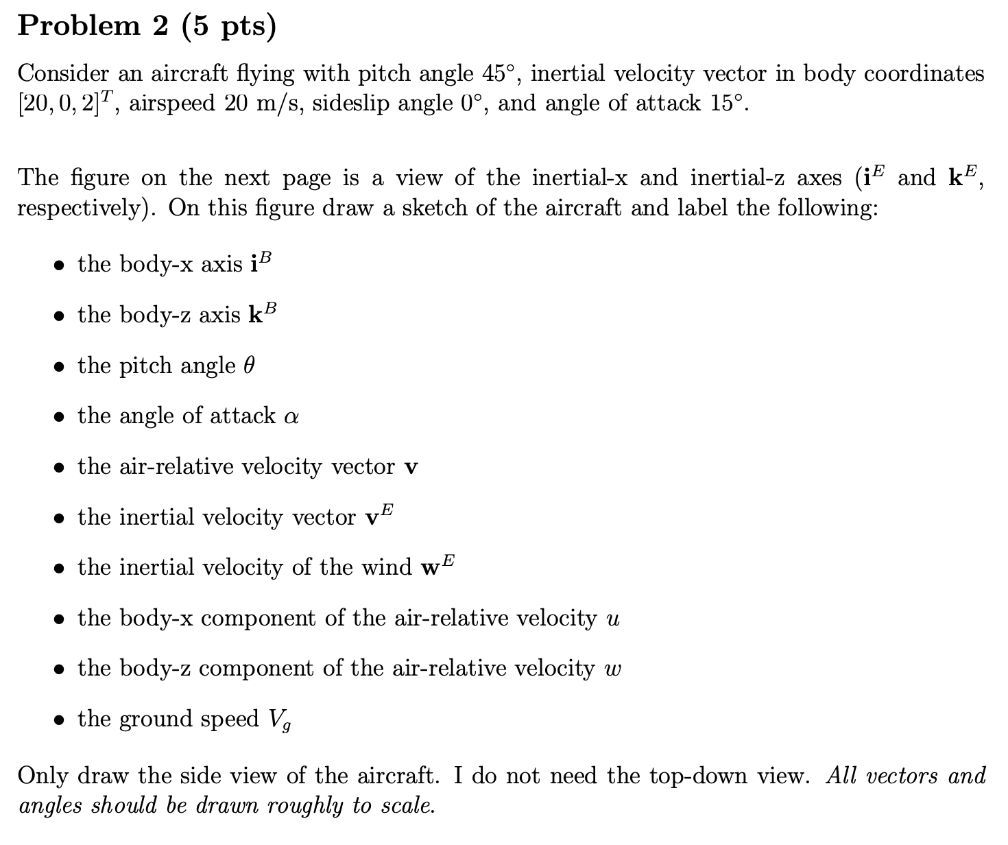
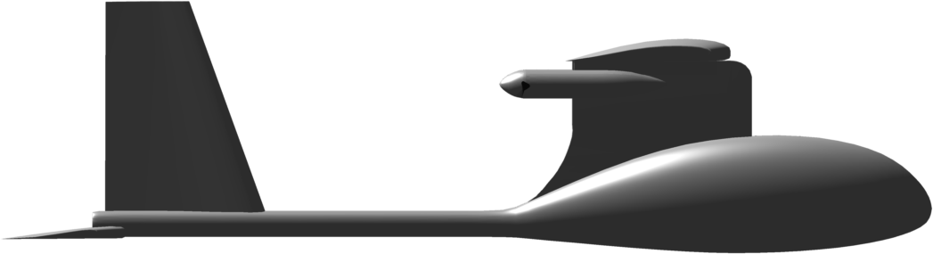
2021: Problem 2
i_{E}
k_{E}

Slide 11
i_{B}
θ
k_{B}

Slide 12
i_{B}
v^{E}
w^{E}
v
α
The angle is defined as positive from the body x-axis to the air relative velocity vector.
Typically, the arrow for an angle points in the positive direction. There is no standard, so I did not deduct points for this, but be aware in the future.
θ
k_{B}

Slide 13
i_{B}
v^{E}
w^{E}
v
α
u and w are not the same as u^{E} and w^{E}
u and w are not vectors
θ
u
w
k_{B}

Slide 14
i_{B}
v^{E}
w^{E}
V_{g}
v
α
ground speed V_{g} is not a vector
ground speed is the magnitude of v^{E} and needs to be labelled as such
θ
u
w
k_{B}

Slide 15
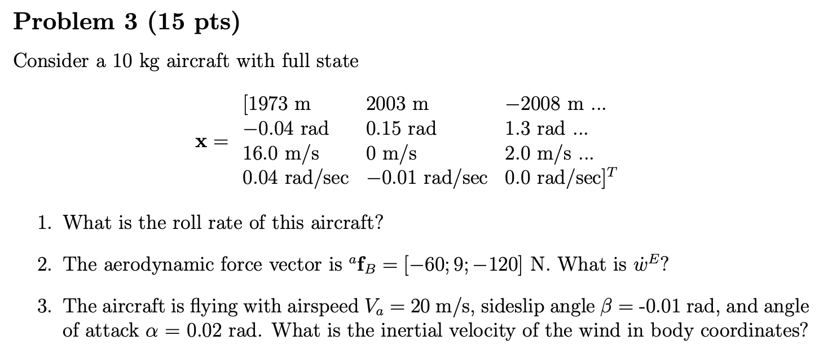
2021: Problem 3

Slide 16
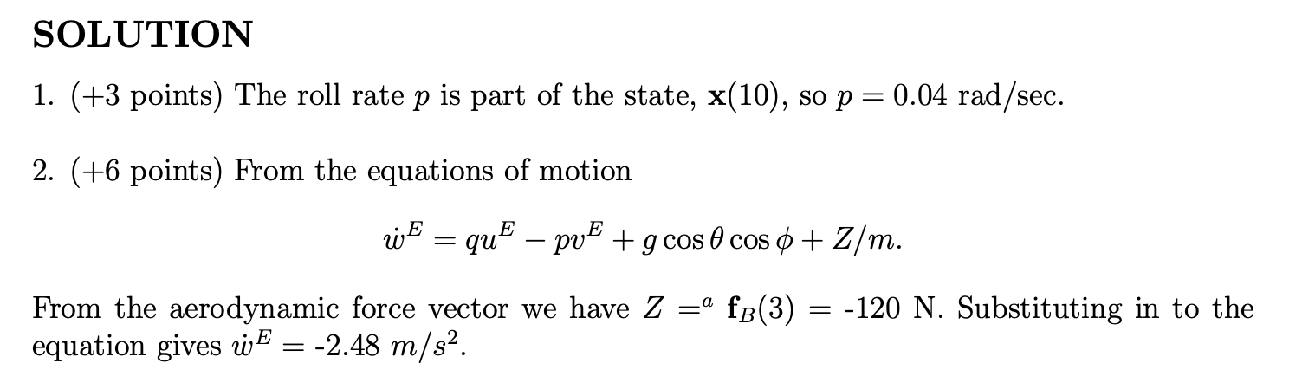
2021: Problem 3

Slide 17
2021: Problem 3

Slide 18
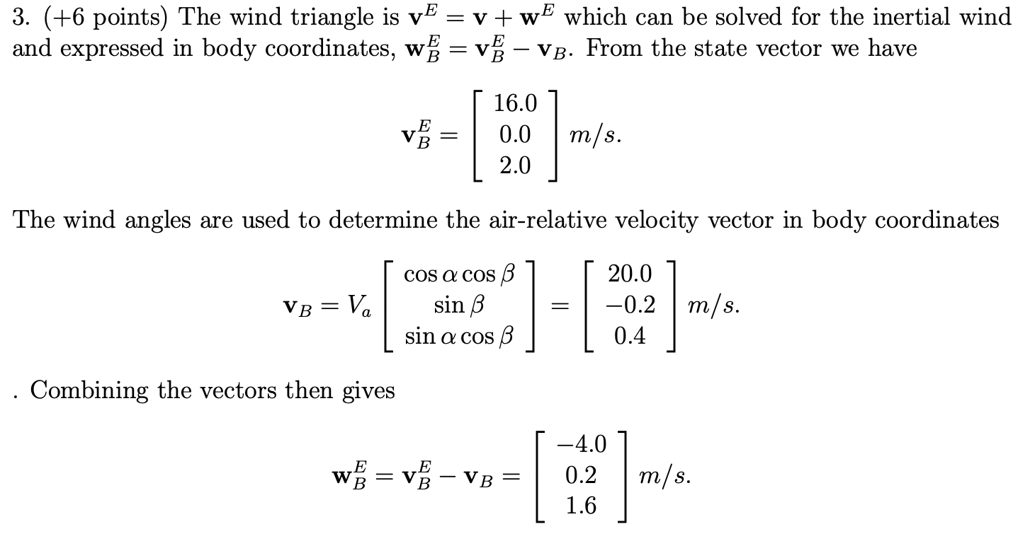
2021: Problem 3

